Slide 1

Big Data Analytics (21CS71) Module 03 No SQL Data architecture
By – Aditi DAS
AIT21BECS073
1AY21CS014

Slide 2
3.3 NOSQL DATA ARCHITECTURE PATTERNS
Object Data store Overview Use Cases Data Modelling API & Functionality Meta data & Object Object relational mapping Graph database Overview Use Cases Characterises & Examples Variations of NoSQL Overview

Slide 3
Object Data store
Overview of Object Data Store:
An Object Data Store is a type of NoSQL database that stores data in the form of objects, similar to object-oriented programming.
Objects such as files , documents , business reports and meta data – both system and custom metadata.
It is designed to store and manage complex, hierarchical, and unstructured data, providing flexibility in data representation.

Slide 4
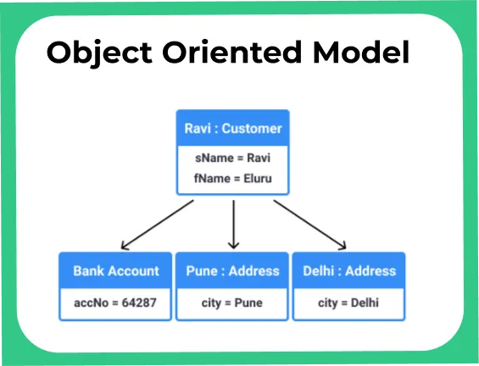
Object Data store
Use Cases:
Product Catalogs They are beneficial for storing product information with complex attributes and relationships.
Customer Relationship Management (CRM) Object Data Stores can be used to store customer profiles and interactions in a flexible and scalable manner.

Slide 5
Object Data store
Data Modeling:
OODBs naturally handle complex data structures and relationships. Because they hold data in objects, they can easily represent intricate data models without requiring multiple tables and joins.
Data is represented as objects with attributes and relationships, allowing for nested and complex structures.

Slide 6
Object Data store
API and Functionality:
Object Data Stores provide APIs for CRUD (Create, Read, Update, Delete) operations on objects.
They support functions for indexing, querying, and aggregating data, enabling efficient data retrieval and analysis.
APIs are designed to handle large collections of objects and provide scalability for data-intensive applications.

Slide 7
Object Data store
Metadata and Object Store:
Object Data Stores maintain metadata that describes the structure and properties of stored objects.
Metadata interfaces provide information about object attributes, relationships, and indexing.
In the context of Big Data, Object Data Stores can efficiently handle large volumes of complex and unstructured data, leveraging metadata for organization and retrieval.

Slide 8
Object Data store
Object Store development platforms:
Amazon S3 and Microsoft Azure BLOB:
Scalable Object Storage:Amazon S3 and Microsoft Azure BLOB provide scalable object storage infrastructure, supporting the storage and retrieval of large volumes of objects.

Slide 9
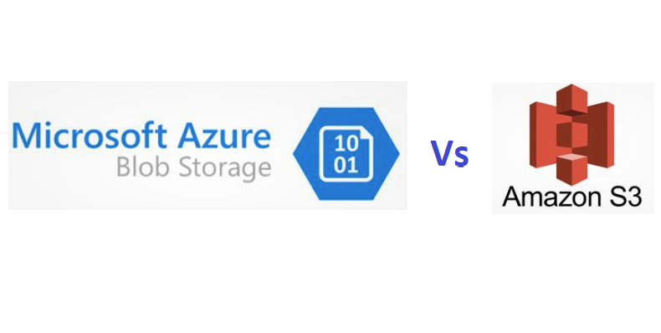
Object Data store
Object Store development platforms:
Amazon S3 and Microsoft Azure BLOB:
API Support: Both Amazon S3 and Microsoft Azure BLOB offer comprehensive API support for managing and integrating object storage, enabling seamless data operations and interactions.

Slide 10
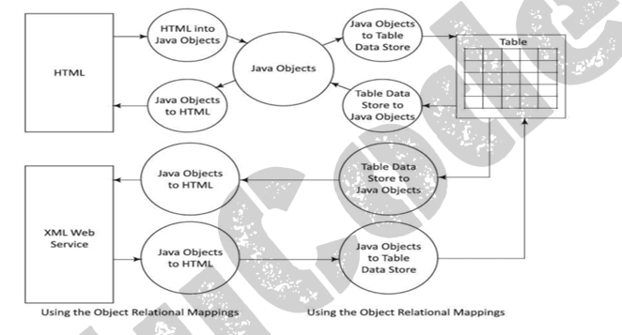
Object Relational Mapping
Object relational mapping of HTML document and XML web service store with the tabular data store:

Slide 11
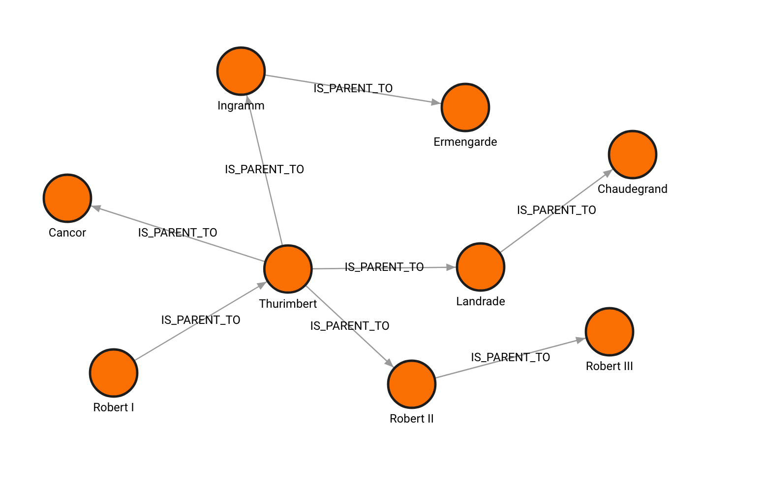
Graph Database
Introduction to Graph Databases:
Unique Characteristics:Graph databases are designed to represent and store data in the form of nodes and edges, allowing for efficient management of complex relationships and interconnected data.
Relationship-Centric Data Storage: They focus on the relationships between data entities, providing a flexible and intuitive way to model and query connected data.

Slide 12
Graph Database
Use Cases:
Link Analysis: Graph databases are used for link analysis to perform searches and identify patterns and relationships in various scenarios, such as social networking, telephone, or email records.
Friend of Friend Queries: They are beneficial for executing friend of friend queries, enabling the exploration of indirect connections and relationships within a network.

Slide 13
Graph Database
Use Cases:
Recommendation engines
Fraud detection analysis
Bioinformatics
Supply chain management
Network and infrastructure management

Slide 14
Graph Database
Characteristics of Graph Databases:
Specialized Query Languages:Graph databases use specialized query languages, such as RDF(Resource description frame) using SPARQL, to express complex graph patterns and relationships.
Unique Data Modeling: They model data in a fundamentally different way compared to other database models like key-value, document, columnar, and object data stores, focusing on relationships and interconnected data.

Slide 15
Graph Database
Characteristics of Graph Databases:
Hyper-Edges and Hypergraphs: Graph databases can represent hyper-edges, which are sets of vertices in a hypergraph, allowing for the generalization of graph structures to join any number of vertices.
Small Data Size Records:They consist of small data size records with complex interactions between graph nodes and hypergraph nodes, enabling the representation of intricate relationships and patterns.

Slide 16
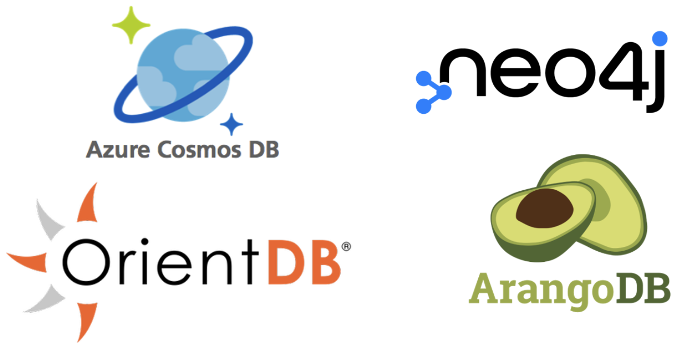
Graph Database
Examples of graph database :

Slide 17
Variations of NoSQL
In NoSQL, "variations" refer to the different types of data models or structures that NoSQL databases use to store and manage data. Each variation addresses specific data handling requirements, depending on the nature of the data, access patterns, and performance needs.
1. Key-value stores
2. Document stores
3. Column-Family Stores
4. Graph Databases
5. Object Stores

Slide 18
Variations of NoSQL
Each NoSQL variation serves specific data needs:
Key-Value and Document Stores: Excellent for high-speed data retrieval and flexibility.
Column-Family Stores: Best for read-heavy workloads and analytics.
Graph Databases: Ideal for applications with intricate relationships.
Object Stores: Efficient for handling large binary files and unstructured data.
The choice depends on the application requirements, data type, scalability needs, and complexity of relationships.

Slide 19


